Slide 1
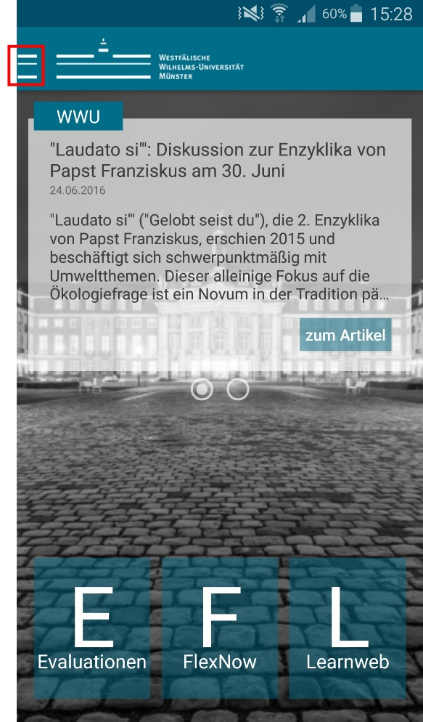
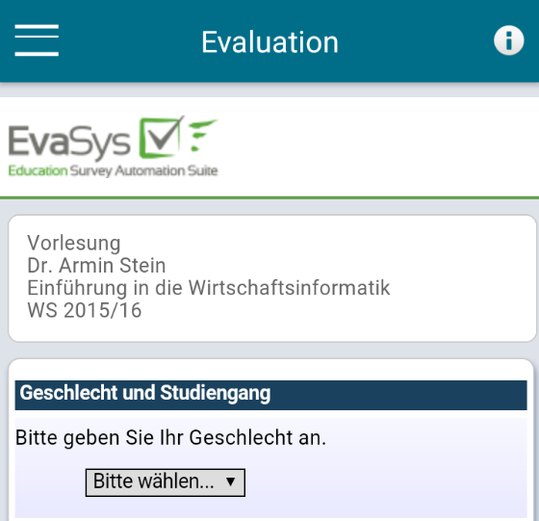
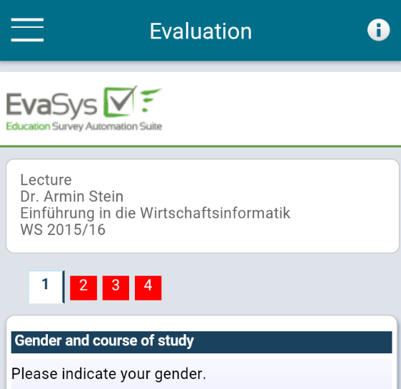
Instructions
Evaluating with the Faculty App
Select the menu point „Evaluations“ from the side bar.
Open the corresponding evaluation in the following menu.
Please pay attention to the type of evaluation shown in the header.
The necessary codes for subject of study and program can be found in the information menu (marked with an „i“).
No compatible device or not willing to use the app? Please follow the link in your inbox.
Everything in this process is anonymized!

Slide 2
Instructions
Evaluating with the Faculty App
Subject | Number for evaluation
Business Administration | 021
Economics | 175
Bachelor Information Systems | 846
Master Information Systems | 952
Politics and Economics | 969
Economics and Law | 946
Joint Degree Economics | 960
Economics and Politics (Teaching at Berufskollegs) | 976
Degree | Number for evaluation
Bachelor | 82
Master | 88
Joint Bachelor degree | 55
Bachelor BK | 56
Master of Education BK | 40
Doctoral studies | 10

